Slide 1
205 Feb 12, Class 18
Non-experimental designs
Correlation
Observational design
Final project planning

Slide 2
Intervention research in child development has repeatedly produced a paradoxical conclusion: In correlational studies, parental assistance with children’s homework has been associated with lower academic achievement. As a result, some psychologists have concluded in published reports that parents should not help their children with homework…

Slide 3
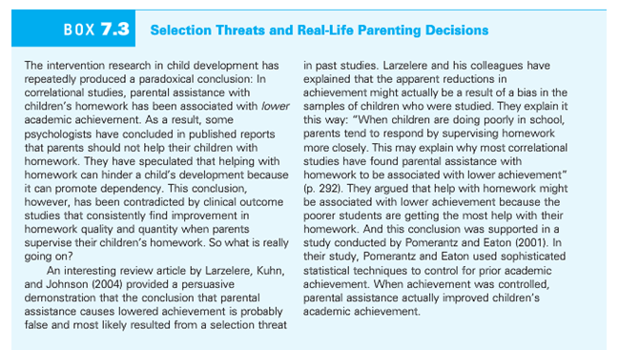

Slide 4
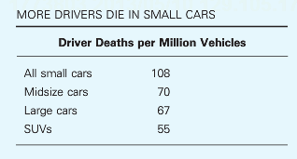
Multiple accounts consistent with the data
Large cars are safer than small cars
Small cars are more dangerous than large cars
Safest cars: Acura RX SUV, Acura RL sedan, Audi 4
Most dangerous cars: Chevy Cobalt, Ford Focus, Mazda 3

Slide 5
Validity
Q1. Why are experimental studies higher in internal validity?
Q2. Why are nonexperimental studies higher in external validity?

Slide 6
Non-experimental design
For each of the following 3 examples, indicate what kinds of non-experimental design would be used to study the phenomenon and also outline a 2-group experimental approach that could answer a question that might be inspired by the non-experimental work.
3a. Pushing ahead in line
3b. Increased crime rates during higher temperature months
3c. Studiousness in college students

Slide 7
Correlations
For each of the following statistical relationships, decide whether the directionality problem is present and think of at least one plausible third variable.
4a. People who eat more lobster tend to live longer.
4b. People who exercise more tend to weigh less.
4c. College students who drink more alcohol tend to have poorer grades.

Slide 8
Causality
If variables X & Y are very strongly correlated, does X cause Y?
Correlation between X & Y means either
X causes Y
Y causes X
Z causes both X and Y

Slide 9
Variables observed to co-vary
Hot weather is associated with higher rates of street violence
Older people exercise less than middle aged people
A college education increases people’s SAT scores

Slide 10
Famous Psychology Studies
Stanley Milgram found that about two thirds of his research participants were willing to administer dangerous shocks to another person just because they were told to by an authority figure (Milgram, 1963).
Elizabeth Loftus and Jacqueline Pickrell showed that it is relatively easy to “implant” false memories in people by repeatedly asking them about childhood events that did not actually happen to them (Loftus & Pickrell, 1995).

Slide 11
Final project status
Groups
Project ideas

Slide 12
Non-experimental designs
Collected in the real world outside the laboratory
Observation
Surveys
Qualitative research
Lack of control = less internal validity
As little as none in some cases
Collecting data in context = greater external validity
Little concern about applying outside the lab

Slide 13
For Wed Feb 14
Read Plant et al. (2009), The Obama Effect
Chapter 15: Surveys

Slide 14
Sugar and hyperactivity in children
“Sugar rush”: candy, cake, etc., leads to high-activity behavior in children
Why do many people think this is true?
What is the role of experimental versus non-experimental data in this common belief?

Slide 15
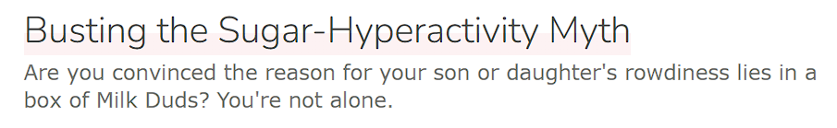
Experimental Research on Sugar
How would we design a study to refute this idea?
What is the fundamental problem with our experimental approach?

Slide 16
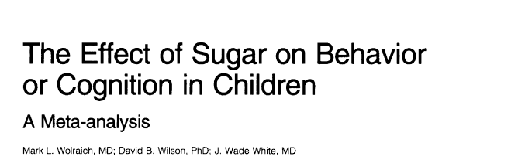
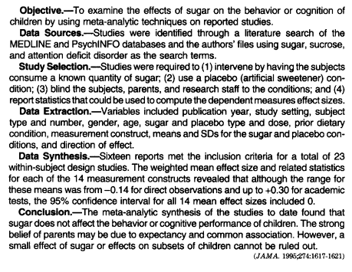
Meta-analysis: combined re-analysis of a set of published research studies
Provides additional sensitivity to small effect sizes
Can be used to argue for effect size = 0

Slide 17
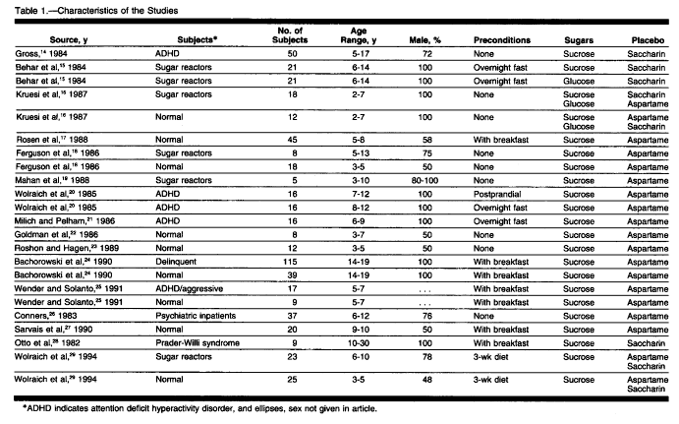

Slide 18
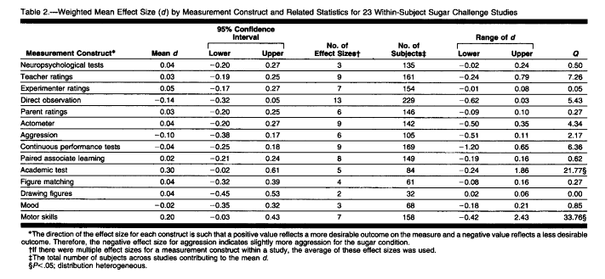

Slide 19
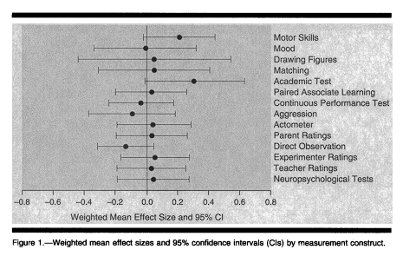
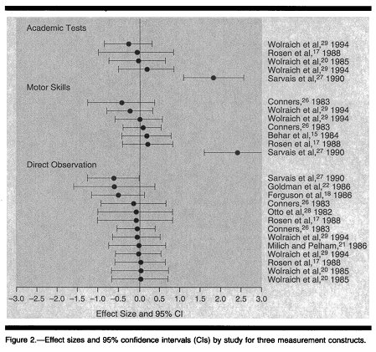
Forest Plots

